Slide 1
Basic Biological Concepts
Homeostasis and Regulation I
Section 3 – Lecture 3

Slide 2
Homeostatic Regulation by Intercellular Communication
Single celled organisms use intercellular signals to coordinate such things as gene expression, mating, sporulation and cell death in response to population density, nutrients, stress and other cues.
Multicellular organisms use intercellular communications to coordinate the activities of their component cells.
The overall purpose is to coordinate the activities of multiple cells in response to the needs of the organism and changes in its environment.

Slide 3
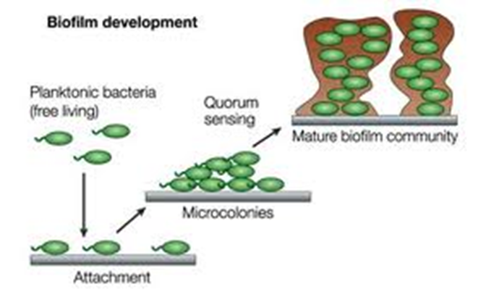
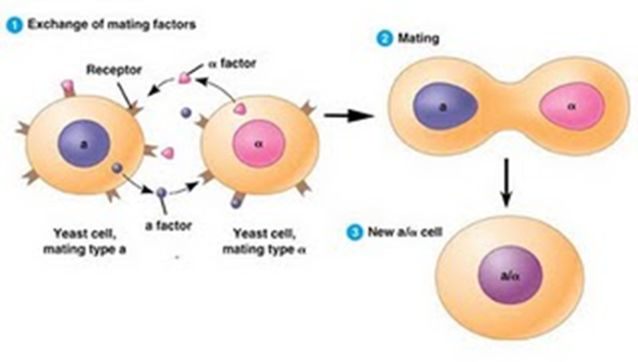
Humans have evolved very complex cell communications systems to regulate our 100 trillion cells
Much of our genetic energy is spent on cell signaling and control.
These pathways are similar to and likely arose from those that single celled organisms use to molecularly sense their environments.

Slide 4
Overview of Signaling System Organization
Communication between two cells or cell types
Some common terminology you will likely encounter
Upstream Cell Downstream Cell
The Sender The Receiver
The Inducer The Responder

Slide 5
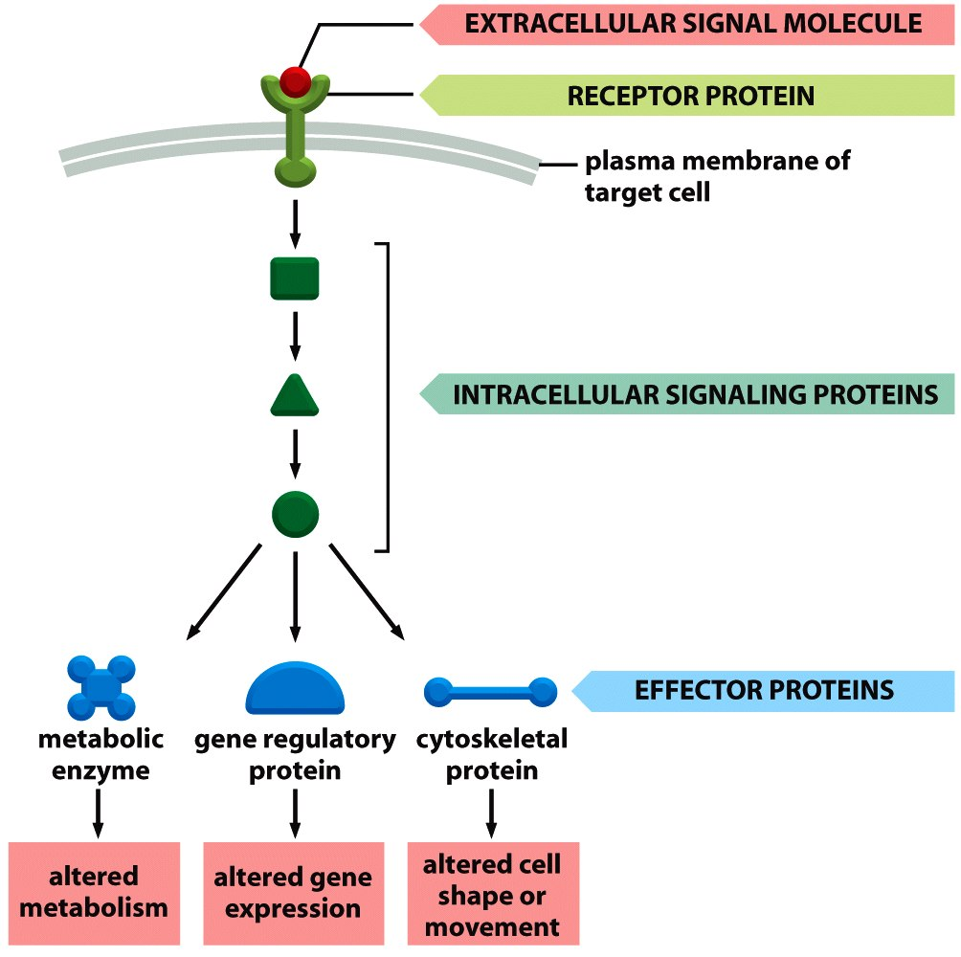
Four components to ALL signals....
Upstream Cell Responsibilities:
1. Ligand Biochemistry
and Mode of Delivery
Downstream Cell Responsibilities
2. Receptor
3. Second Messenger Cascade
4. Target Mechanism(s)

Slide 6
1. Eukaryotic Ligands and ‘Modes of Delivery’
Endocrine signaling – hormones released into the blood stream, systemic coordination, long distance, long duration
Synaptic signaling – neurotransmitters released into synapse, systemic coordination, short or long distance, short duration
Paracrine signaling – signaling molecules released into local fluids, local coordination, short distance,
Juxtacrine signaling – signaling molecules bound to cell surface, coordination of two cells in direct contact, short or long duration
Direct exchange of cytosolic components, coordination of two cells in direct contact, short or long duration

Slide 7
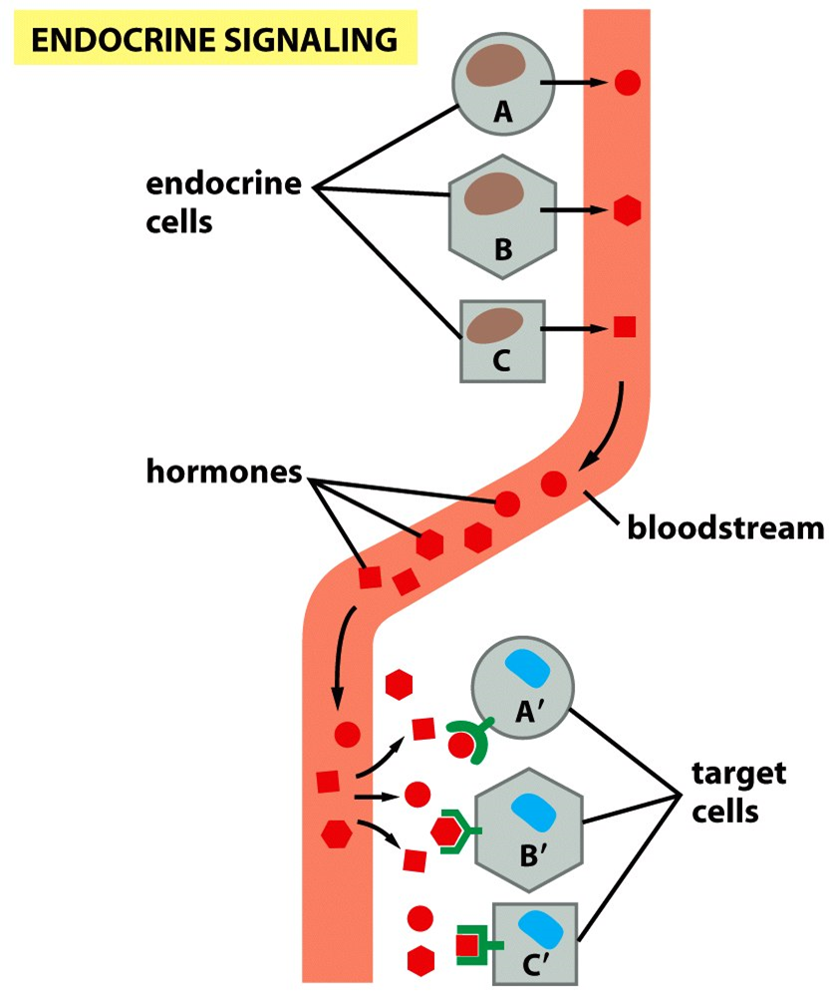
a. Endocrine Signals
The signal molecules of the endocrine system are called hormones
The process is much slower (but longer lasting) than the nervous system
The signaling is more "global" since blood goes everywhere

Slide 8
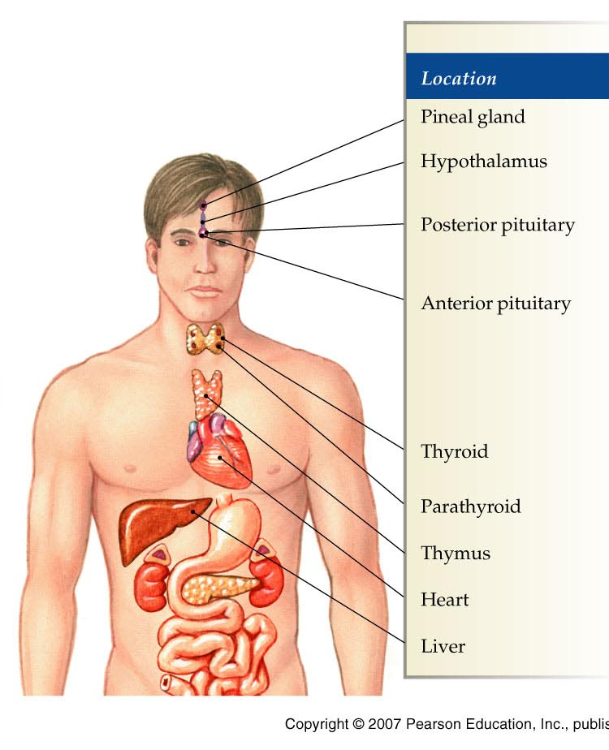
a. Endocrine Signals
Pineal: Melatonin, dimethyl tryptonen
Hypothalamus: Oxytocin, anti-diuretic hormone, growth hormone releasing hormone somatostatin, gonadotropin releasing hormone
Pituitary Gland: Growth hormone, prolactin, melanocyte stimulating hormone, thyroid stimulating hormone, adrenocortico-hormone, follicle stimulating hormone, luteinizing hormone
Thyroid: Thyroxin (T4), Triiodothyranine (T3)
Parathyroid: Calcitonin, parathyroid hormone
Thymus: Thymic factor, thymosin, thymic humoral factor, thymopoietin.
Heart: Atrial natriuretic peptide
Liver: Insulin-like growth factor, angiotensin,, thrombopoietin

Slide 9
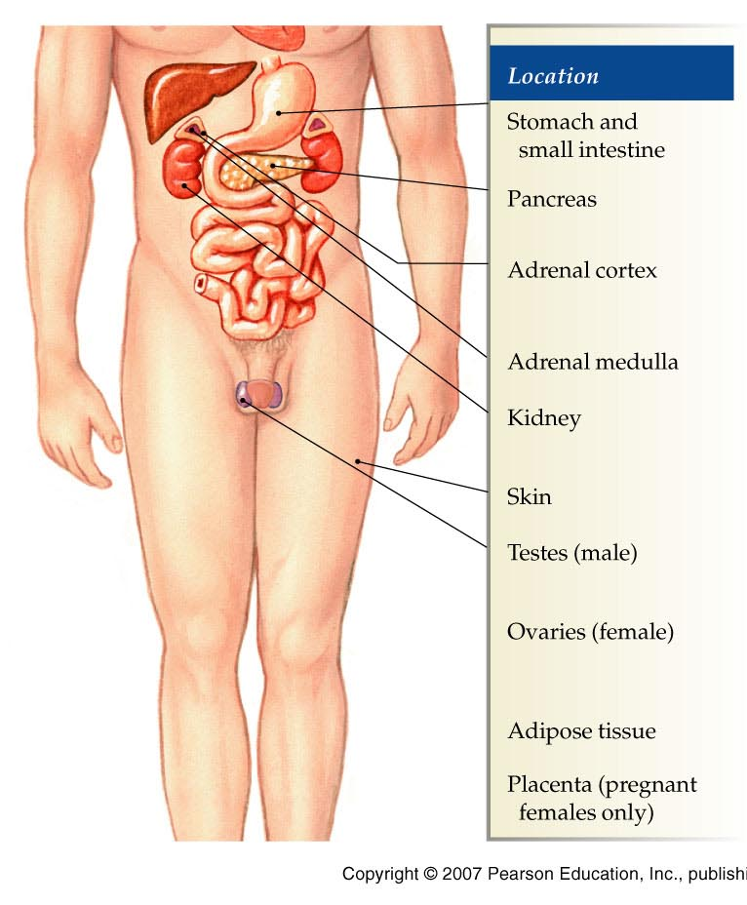
a. Endocrine Signals
Stomach: Ghrelin, gastrin, neuropeptide-y, somatostatin, histamine, endothelin 1
Duodenum: Secretin, cholecystekinin
Pancreas: Insulin, glucagon
Adrenal Cortex: Cortisol, aldosterone
Adrenal Medulla: Adrenaline
Kidney: Renin, angiotensin, erythropoietin
Skin: Vitamin D
Gonads: Testosterone, estrogen, progesterone
Adipose Tissue: Leptin, grelin, estrogen (not affected by LH and FSH
Uterus and Placenta: Hormones for pregnancy or for fetus, respectively

Slide 10
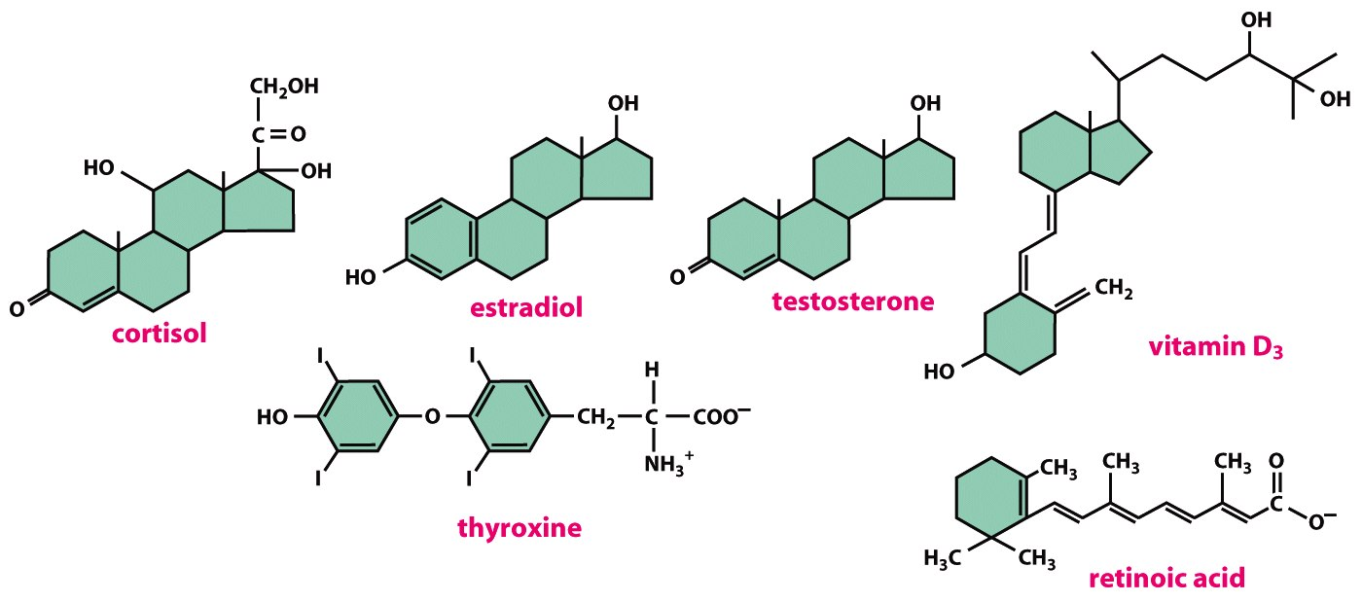
While most ligands are dissolved in the aqueous environment, some are less soluble in water and need carriers to move through the blood
Serum albumin, which accounts for 55% of blood proteins, is a major carrier in the transport of lipids and steroid hormones.
Globulins make up 38% of blood proteins and transport ions, hormones, and lipids assisting in immune function.

Slide 11
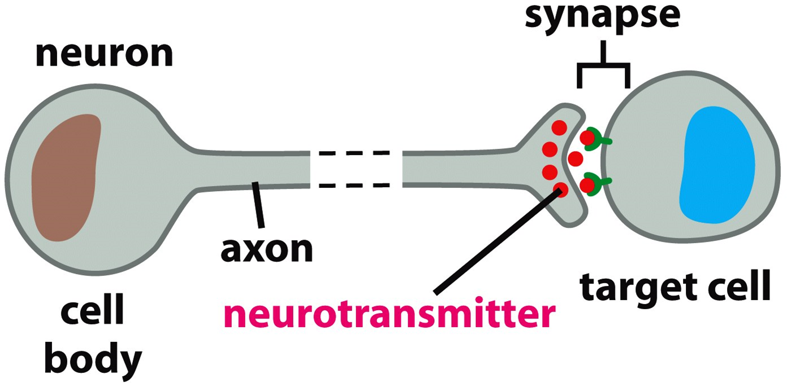
b. Synaptic Signals
A nervous system is an adaptation for systemic regulation in Animalia
Nerves can act long-range like endocrine system
The synapse is a structure that closely binds the upstream and downstream cells and can affect as few as a single cell

Slide 12
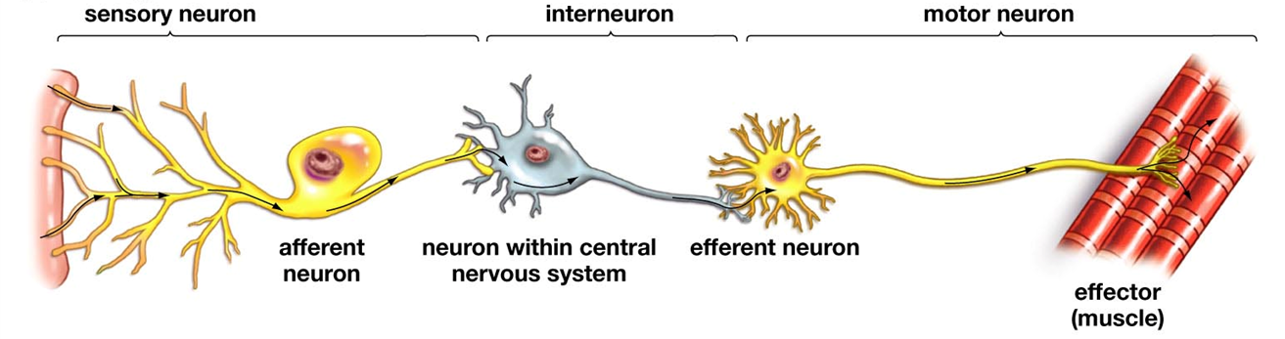
There are 3 basic types of neurons:
Sensory - detect stimuli in the external and internal environments
Motor - signal muscles to contract
Interneuron - make connections between two other neurons

Slide 13
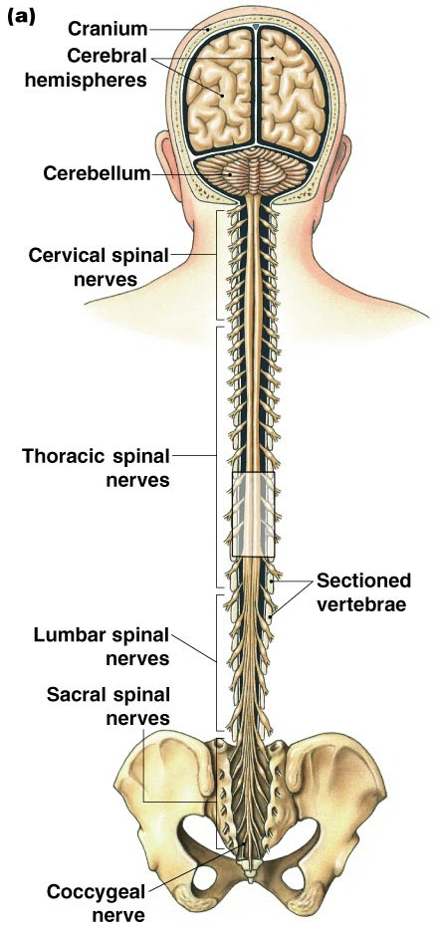
b. Synaptic Signals
Central Nervous System
dopamine
seratonin
glutamate, aspartate, serine, GABA, glycine
histamine
melatonin
adenosine
opioids: endorphin, enkephalin

Slide 14
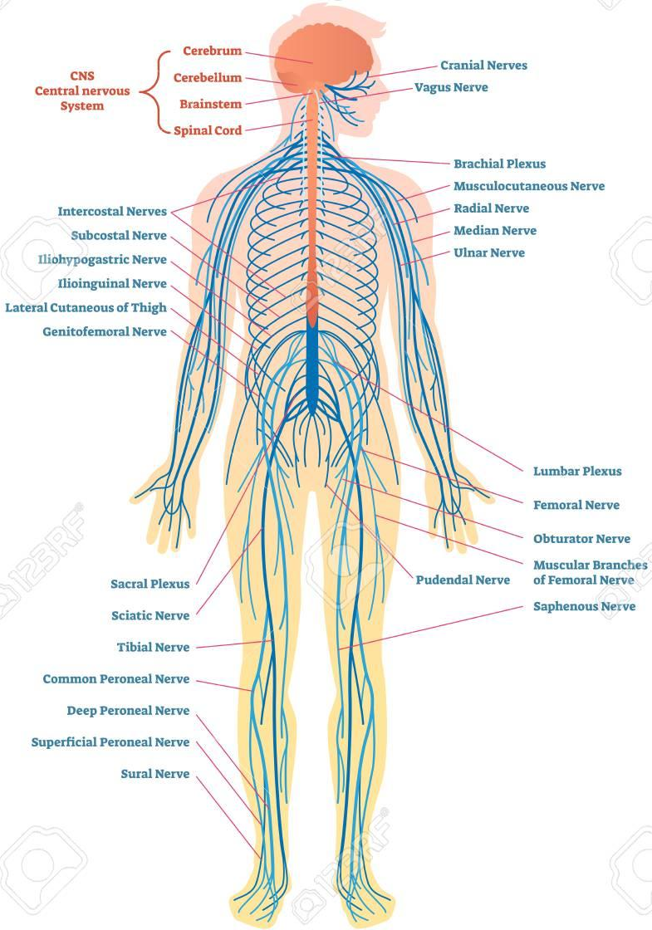
b. Synaptic Signals
Peripheral Nervous System
Somatic N.S.
Motor Neurons: acetylcholine (ACh)
Autonomic N.S
Sympathetic: norephinephrine (NE)
Parasympathetic: acetylcholine (ACh)

Slide 16
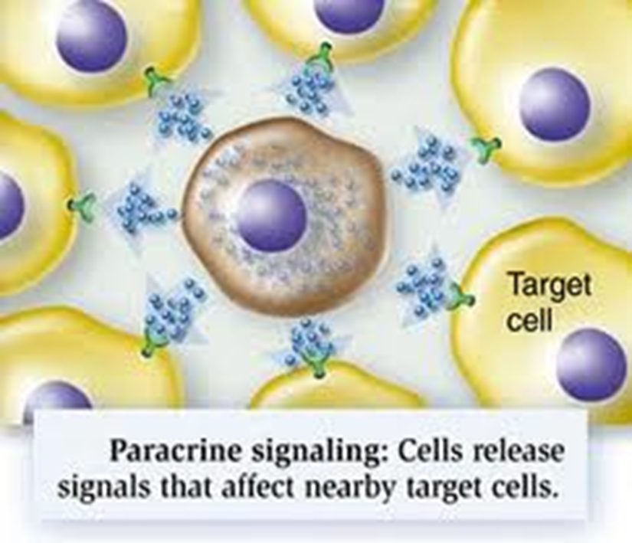
c. Paracrine Signals
Classical growth factors: PDGF, VEGF, FGF, EGF, HGF, Insulin, IGF-1
Neurotrophins, M-CSF
Interferons, interleukins
TGF-β superfamily: TGF-β, activins, BMPs
Hedgehog family
Wnt family growth factors
Gasses: CO, NO
Thrombin, relaxin, fas-ligand
Testosterone, estrogen, progesterone

Slide 17
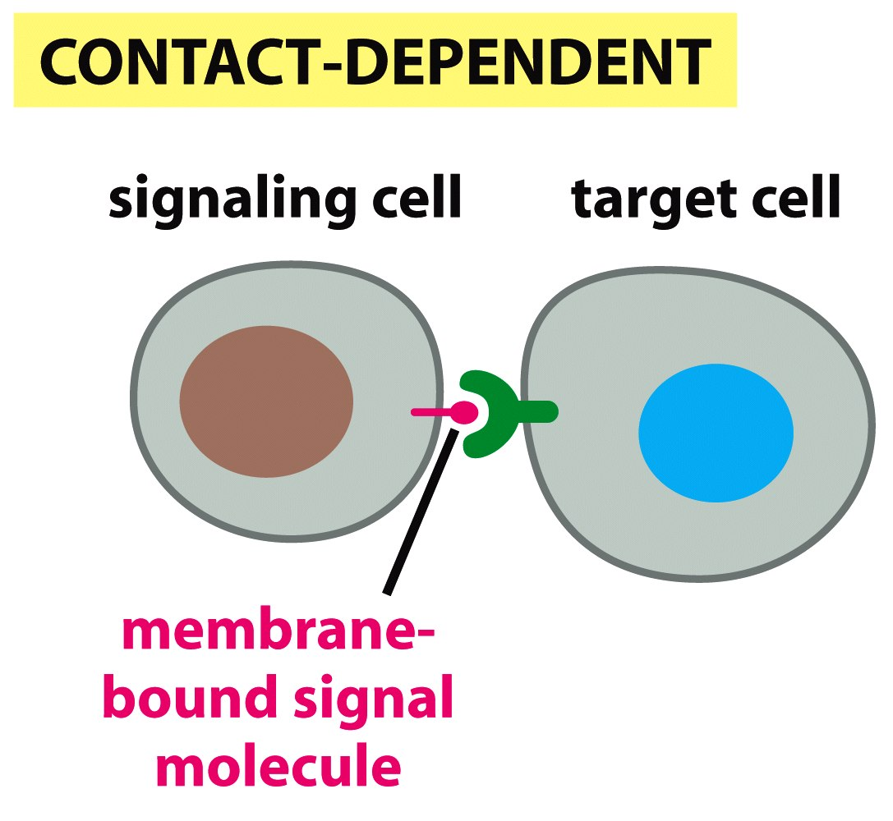
d. Juxtacrine Signals
Cell surface-bound molecules
1. cadherin-cadherin
2. delta-notch
3. ephs-ephrins
4. integrins-Ig family CAMs
also works
on molecules
in the ECM
Immobilized ligands on each cell produce a response in both when they bind to their partner.

Slide 18
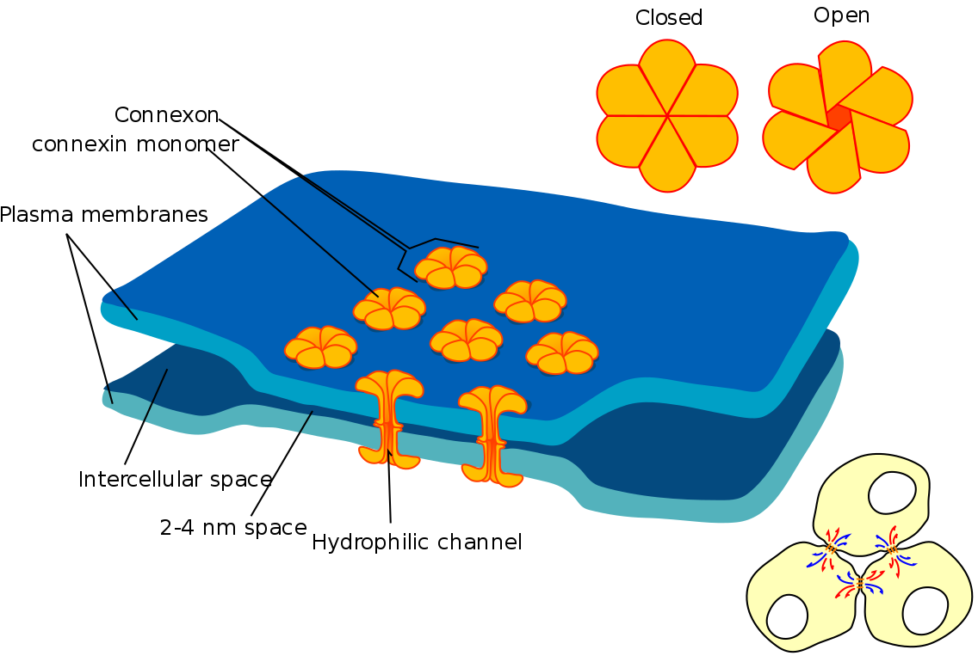
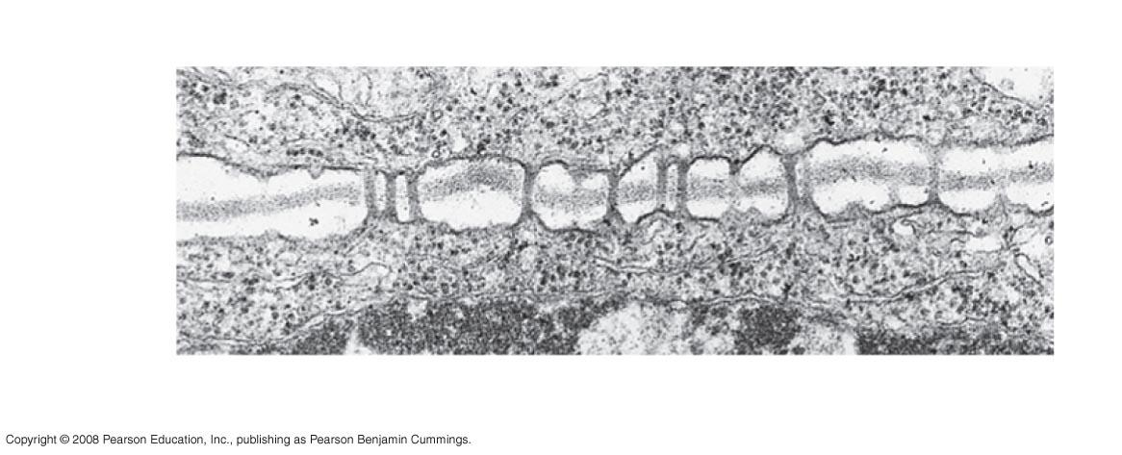
e. Cytosolic sharing
Direct transfer of cytosolic contents from one cell to another.
Coordinates both cells to respond in a similar manner
Gap Junctions in Animal Cells
Plasmodesmata in Plant Cells
Cell walls
Interior of cell
Interior of cell
0.5 µm
Plasmodesmata
Plasma membranes
Notes:
Figure 6.31 Plasmodesmata between plant cells
Plasmodesmata are channels that perforate plant cell walls
Through plasmodesmata, water and small solutes (and sometimes proteins and RNA) can pass from cell to cell

Slide 19
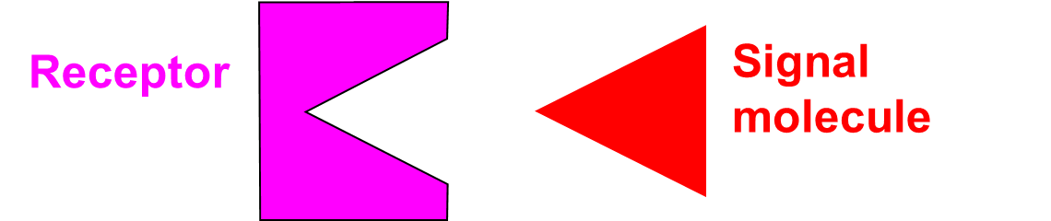
2. A Closer Look at Downstream Cell Receptors
All receptors have a binding site that has a very specific size and shape, allowing only signal molecules of the correct complimentary size and shape to bind to them
Plasma Membrane Receptors for water soluble signals
Intracellular Receptors for molecules that can pass the membrane

Slide 20
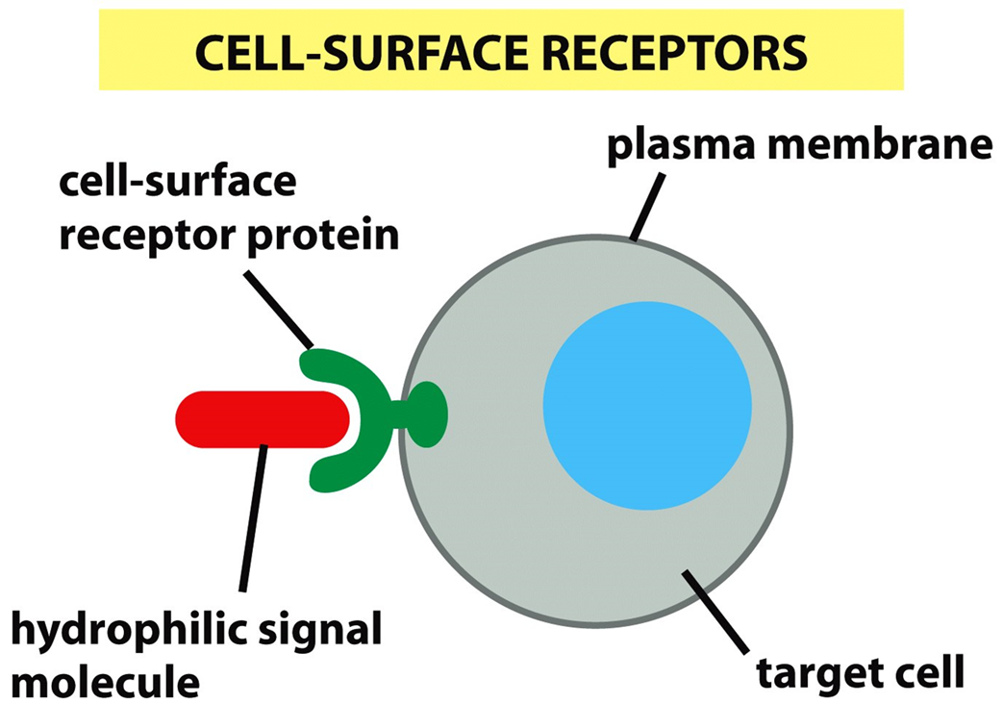
a. Four Basic Classifications of Transmembrane Protein Receptors
G-protein-linked receptors
Enzyme-linked receptors
Specialized growth factor receptors
Ion channel-linked receptors

Slide 21
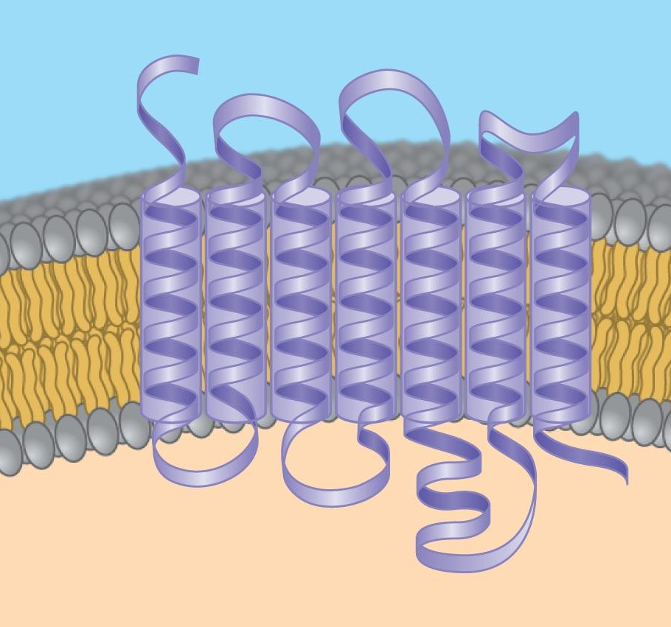
Signaling-molecule binding site on the outside of the cell
1. G protein-coupled receptors
Protein receptors are folded to pass through the membrane 12 times
G proteins are energy requiring 2nd Messenger molecules
When the G-protein is activated the cell must undergo coordinated change
Internal segment that interacts with G proteins
Notes:
Figure 11.7 Membrane receptors—G protein-coupled receptors, part 1

Slide 22
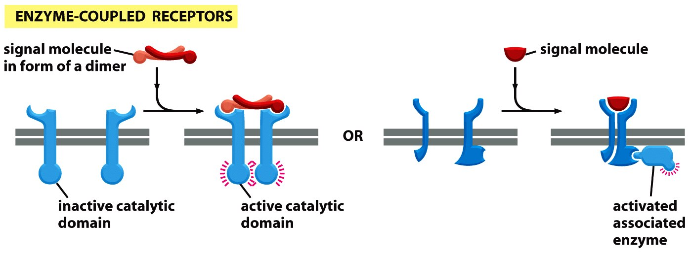
2. Enzyme-Linked Receptors
When the ligand binds outside, an internal enzyme is activated
The receptor protein can be an enzyme or it can associate with an enzyme

Slide 23
3. Specialized Growth Factor Receptors
These receptors can act in very different ways when ligands are bound:
Some activate downstream pathways directly
Some release their blockage of activity inside the cell
Some cause a piece of the receptor to be cut off and cause activity
Some cause pieces of other molecules to get cut off

Slide 24
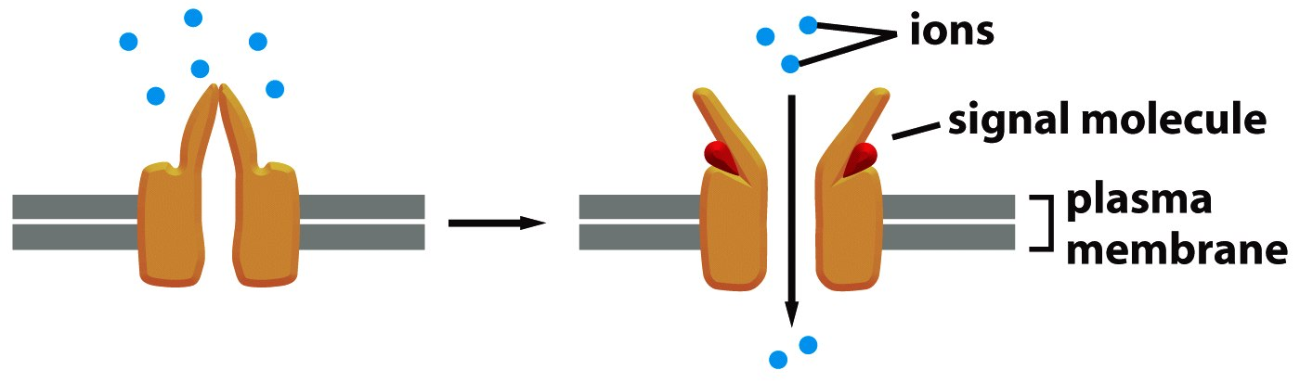
4. Ion Channel-Coupled Receptors open Water-Filled Channels to Allow Stored Ions to Flow Down their Normal Concentration Gradient
Channel is closed in absence of ligand
Ligand-binding opens channel, ions flow

Slide 25
b. Intracellular Receptors
Nuclear receptors – gene transcription activators
steroid hormone receptors
vitamin-D receptors
thyroid hormone receptors
retinoic acid receptor
orphan receptors: a group of receptors inside the cell that we don’t know what they do yet!

Slide 26
3. Second Messenger Cascades
Complexity Equals Control!
Second messenger cascades are built into each cell’s basic structure. If a ligand shows up they must perform the pre-planned activity.
They can seem complex at a level that is completely unnecessary.
Our cells use that complexity to coordinate and integrate multiple signals coming in at once.
And sometimes to make sure you really, really want something to happen – especially if it cannot be reversed later!

Slide 27
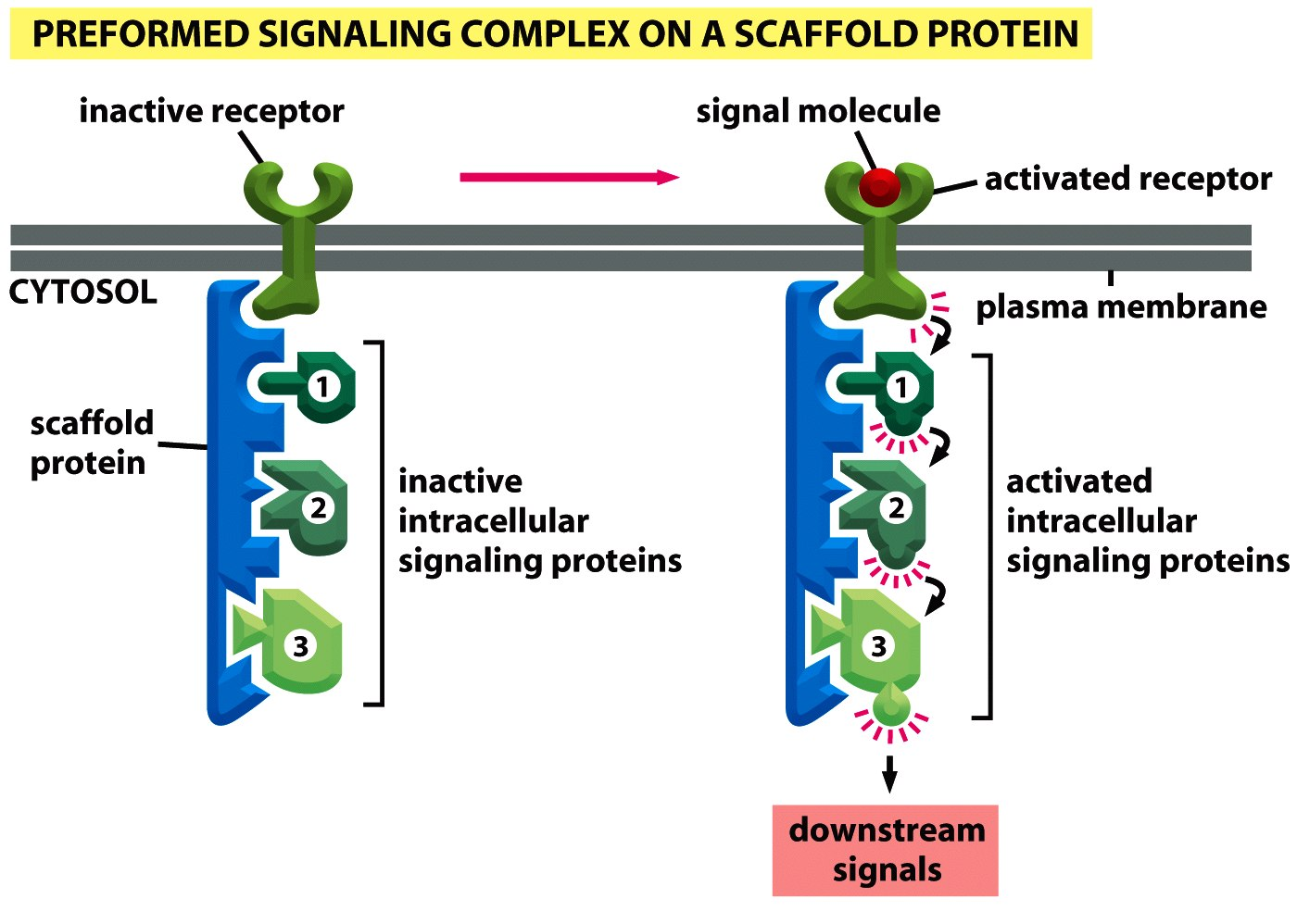
Sometimes the scaffold is set up ahead of time and forms multiple controllable steps directed towards the built-in target mechanism

Slide 28
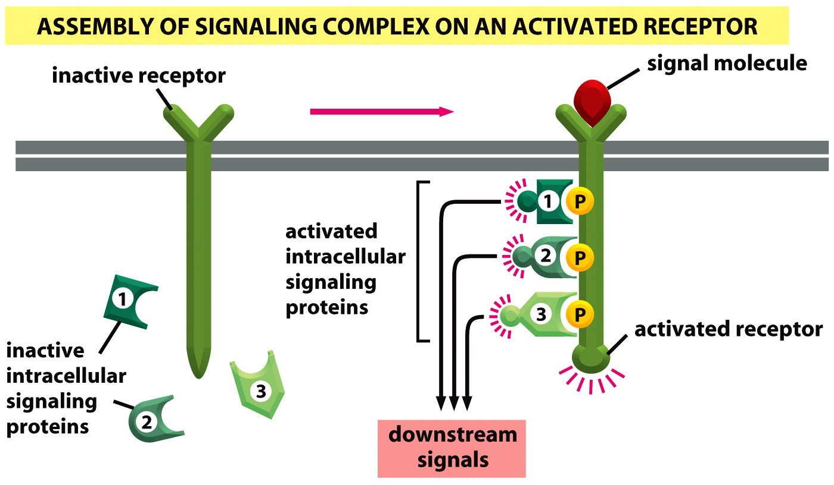
Sometimes receptor activation is required to assemble the scaffold

Slide 29
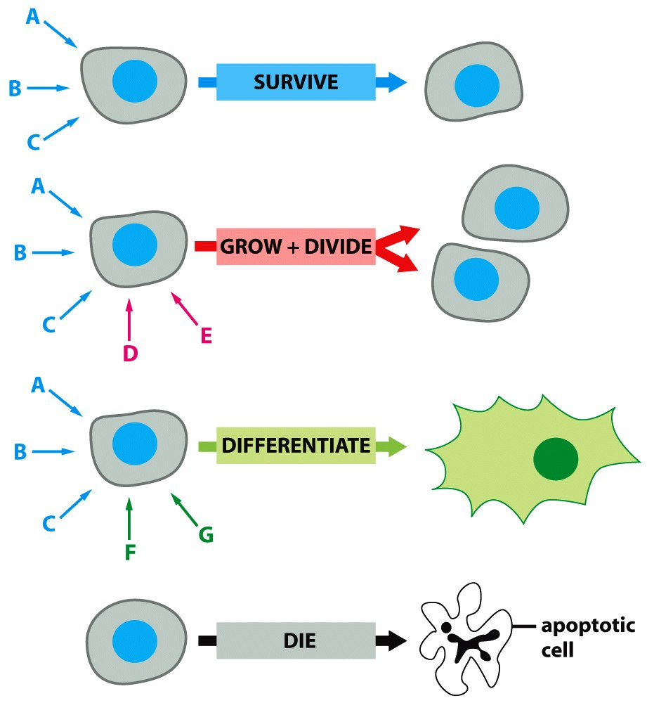
4. Target Mechanisms
Gene Transcription
Cell division, cell death
Rates of enzymes
Endocytosis, exocytosis
Nearly every behavior in a eukaryotic cell can be regulated externally!

Slide 30
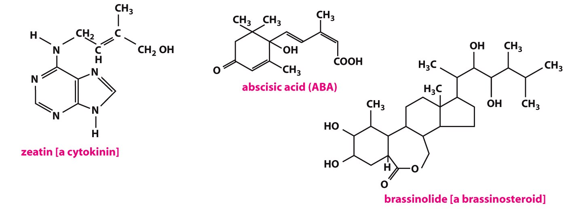
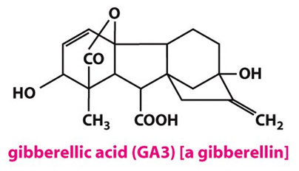
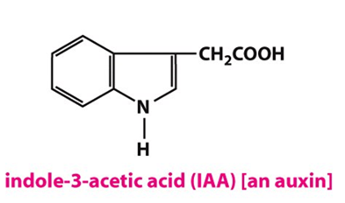
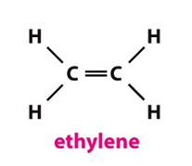
Plant signaling molecules include both growth factors secreted locally and hormones secreted systemically into their vascular system.
Some components are similar to ours:
Membrane receptors
Intracellular receptors
Target mechanisms can be very different!

